Slide 1
Food Recognition using CNN
EE267 Xichang Yu

Slide 2
Motivation
People cares more about what they eat now.
There is a market for this application.
There is enough data.
It is challenging.

Slide 3
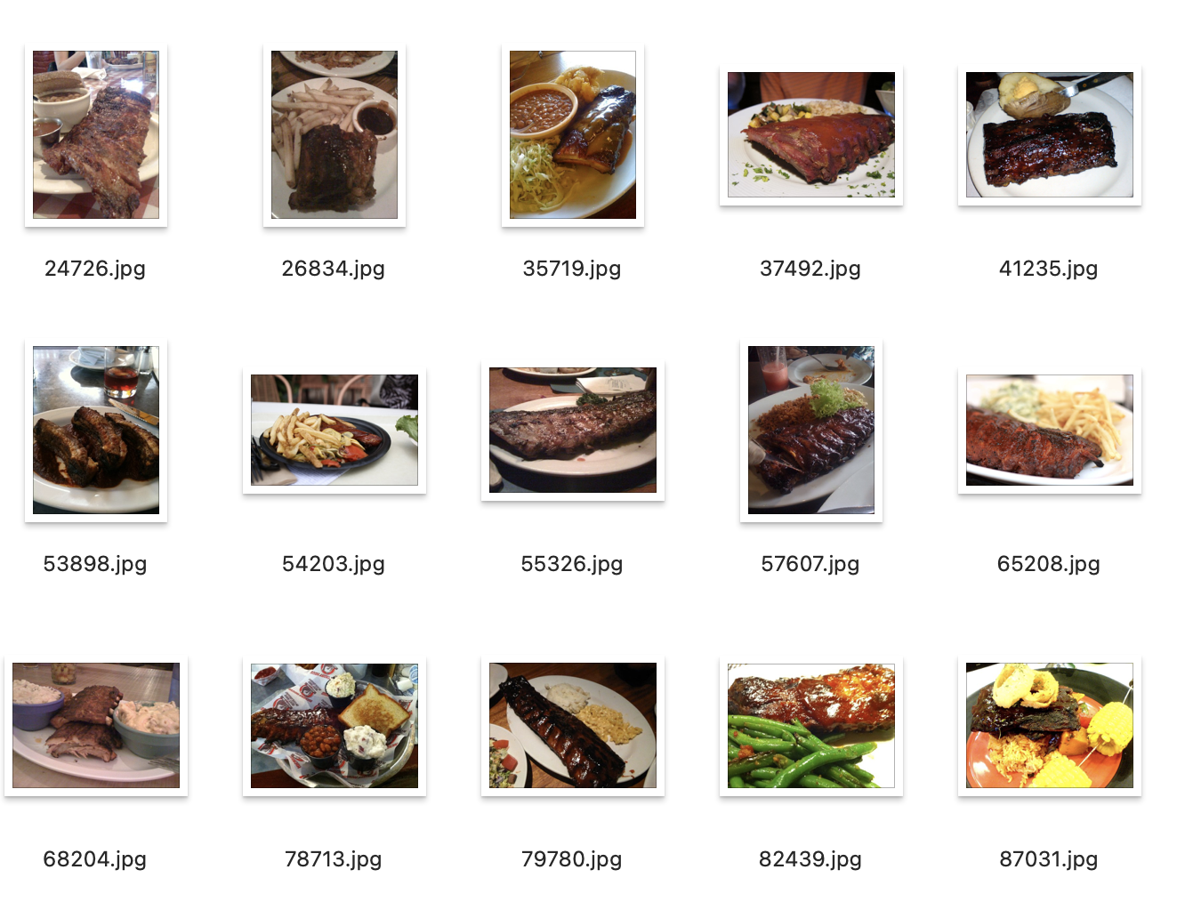
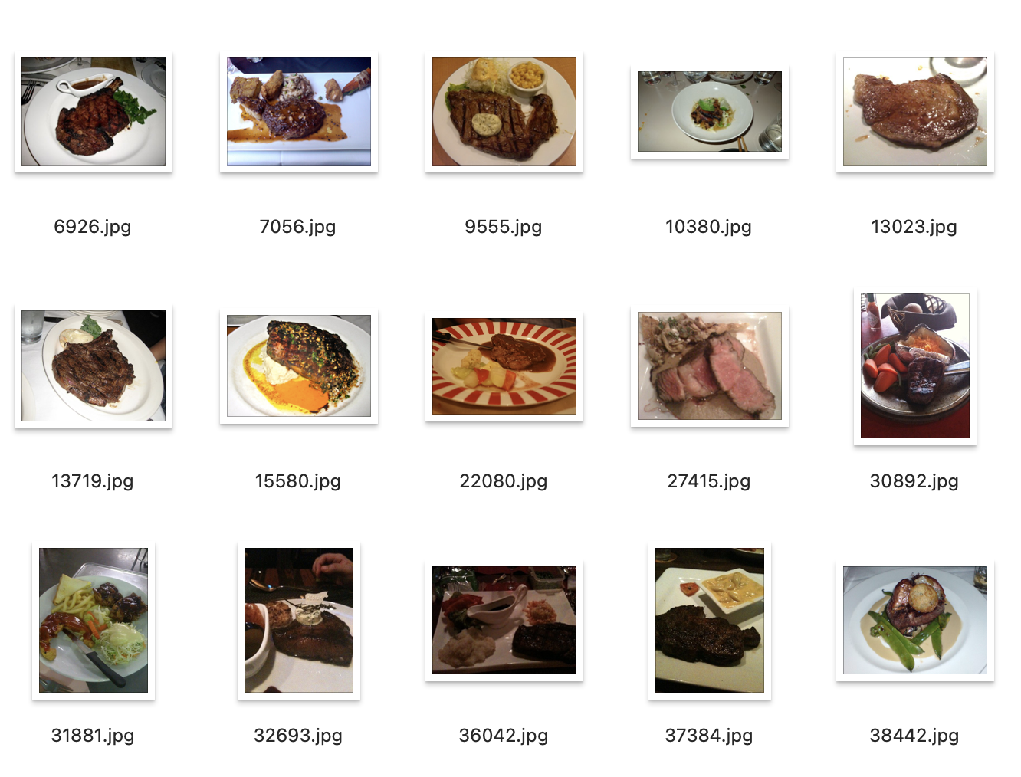
Food 101: 101 classes, 101000 images
8:2 split

Slide 4




Slide 5
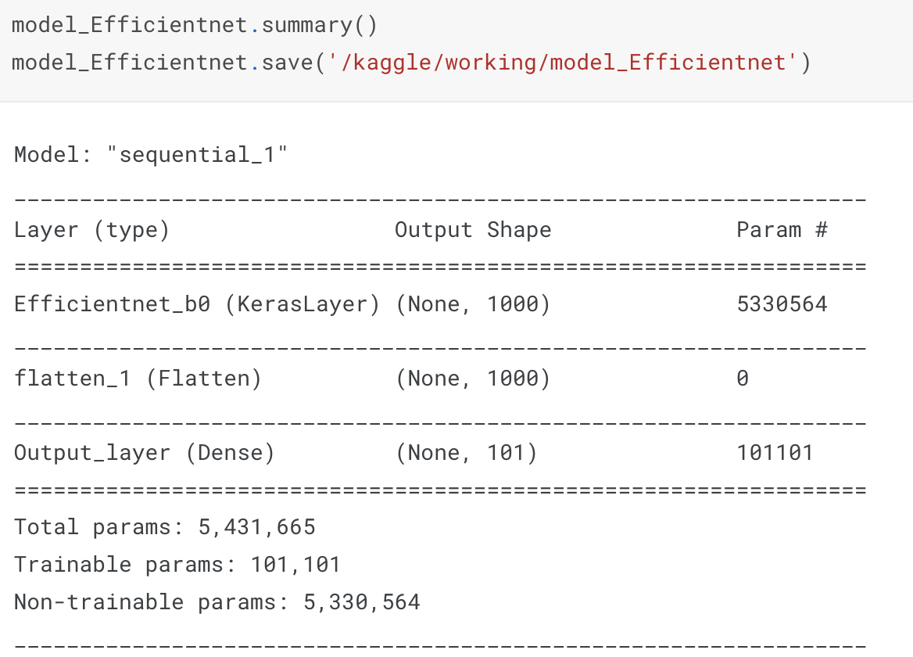
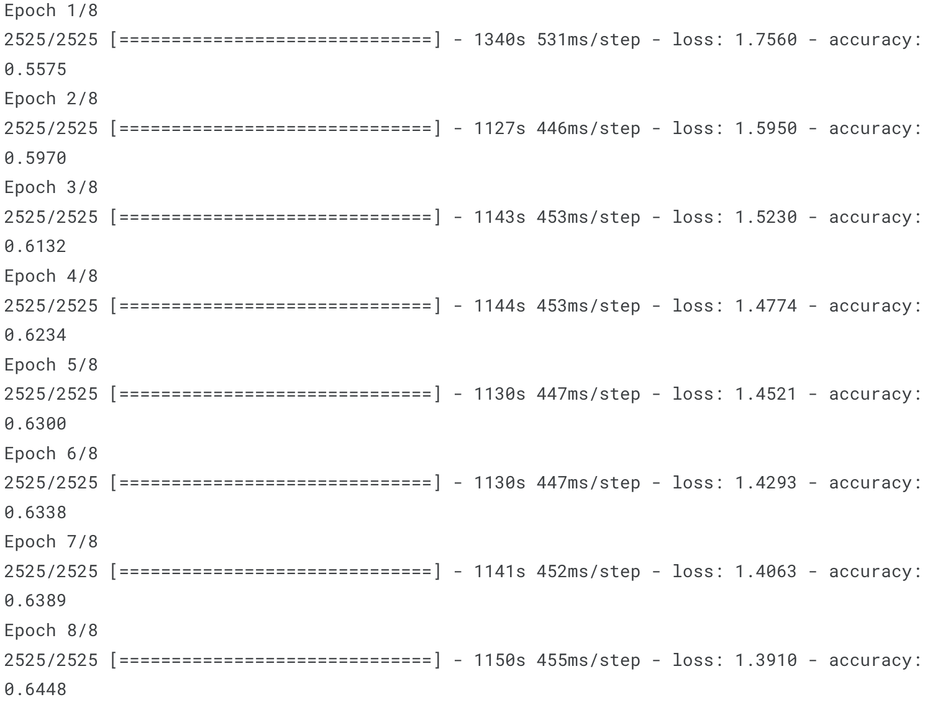
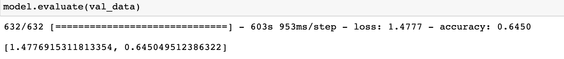
EfficientNetB0
MobileNetV2
InceptionNetV1

Slide 6
Demo

Slide 7
Challenges Encountered
Dataset is big and has a lot of classes(101). Numpy arrays(hw, lab) are not feasible to store dataset. Hard to find a suitable platform to do the training.
(local: lacks hardware,
Colab: unstable, can’t pay with an edu account,
Google cloud: can’t setup a gpu/tpu vm without a pay account,
Kaggle: needs to store dataset on GCS to use TPU)

Slide 8
Future Improvements
More epochs would definitely improve the model.
Train the model on Google cloud.
Deploy it on mobile platforms.
More testing on model training:
Example: Unfreeze the weights of the efficientNet layers and train with a low learning rate
Aim for a test accuracy of 80%+

